Slide 1
High-Tech Potential of Countries
DATA 101 Fall 2025
Project 3 - R. Miranda

Slide 2
Background
What are the characteristics of countries that are advancing high-tech industries?
How can a developing country become a high-tech leader?
First step: identify the countries that have already acquired that status and examine its fundamentals.
This project is meant to take the first step in order to answer those questions.

Slide 3
Measurable indicators
From World Bank:
Country productivity: High-Tech Exports, ICT goods exports, ICT service exports
National resources: Access to electricity, Internet users, Secure servers
Research promotion: R&D expenditure, R&D researchers, Scientific publications
Dataset contains 5400 records, 220 countries and regions; 2000-2024 period.
From United Nations Trade and Development:
Frontier Technology Readiness Index (0:1) =>
Tech_Readiness: low (FTRI 0<0.7); high (FTRI 0.7≤1)
Dataset covers 175 countries in the 2010-2023 period.

Slide 4
Approach
Reduced dataset: 2010-2023 (2400 rows).
Cleaning and EDA.
Split dataset into training (80%) and testing (20%) sets.
Train the full logistic regression model tech_readiness ~ 9 indicators
Assess accuracy and statistical significance of model with the test set.
Predict the NA tech_readiness for the 5400 row dataset.

Slide 5
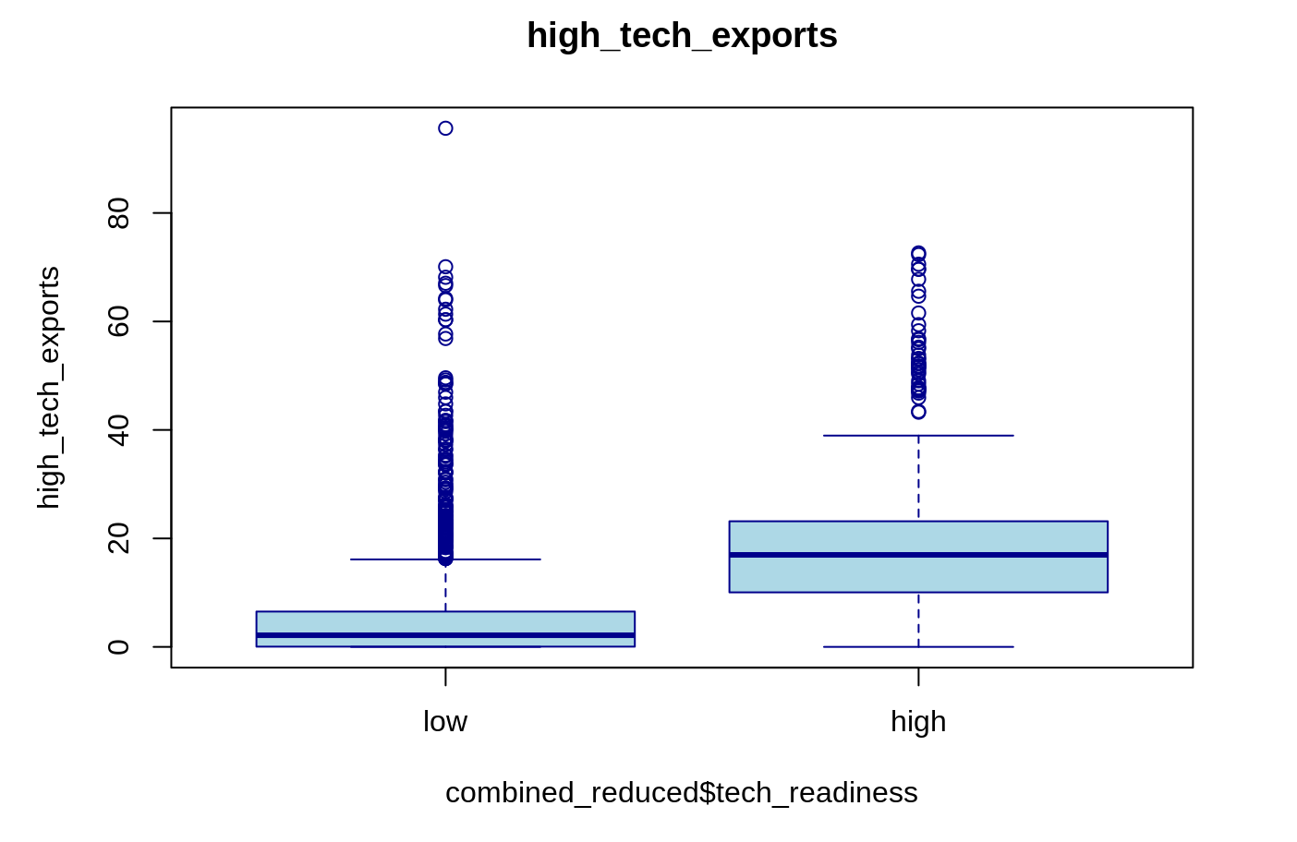
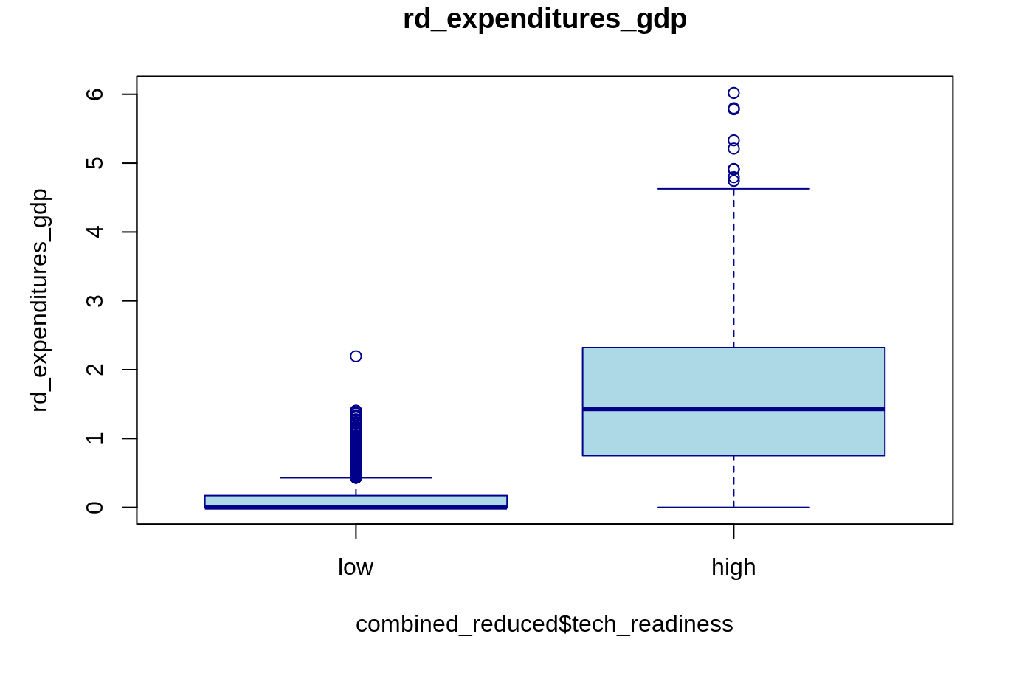
Exploratory data analysis

Slide 6
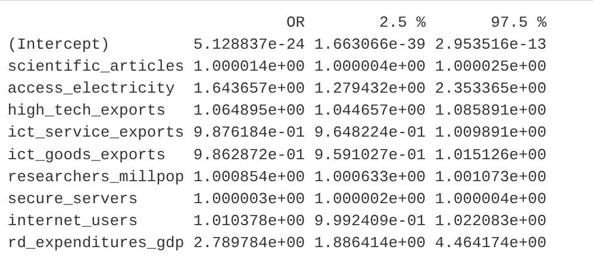
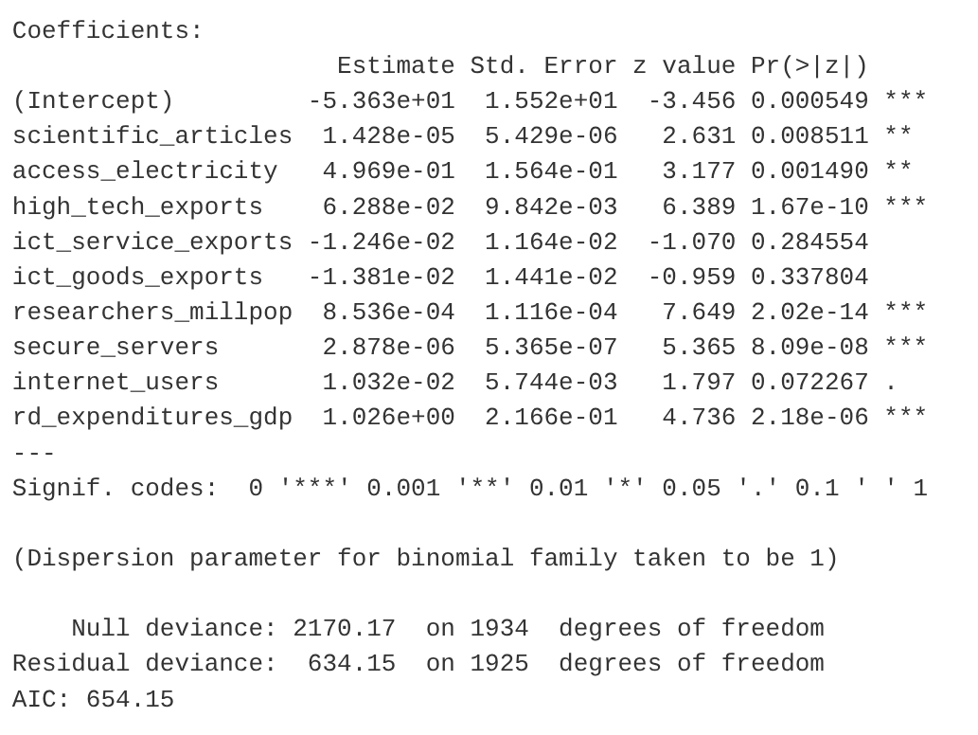
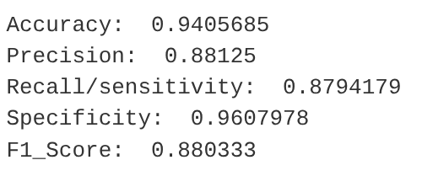
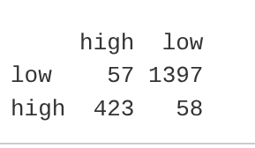
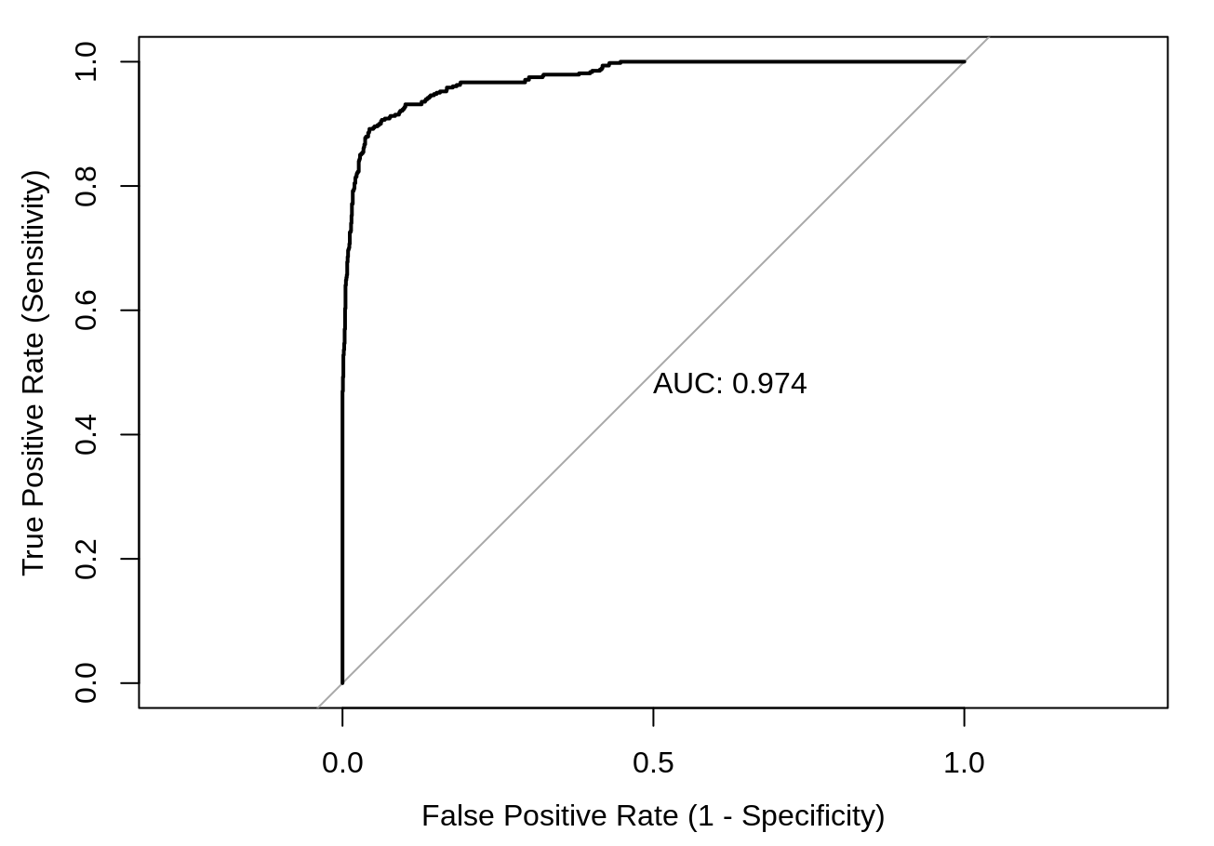
Goodness of fit of model_train
Confusion mtrx
predicted

Slide 7
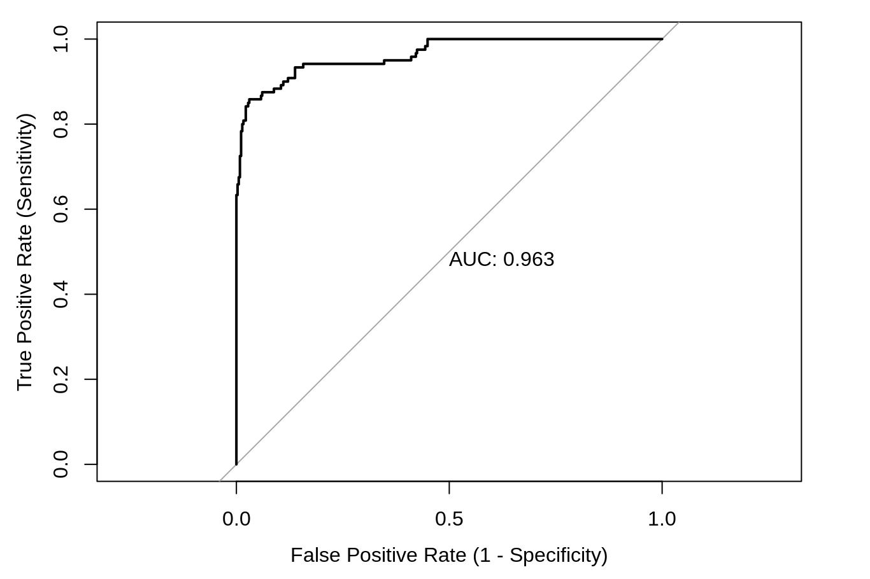
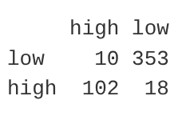
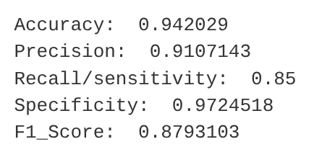
Predicting the test set - with model_train
Confusion mtrx
predicted

Slide 8


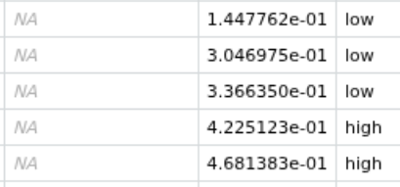
Predicting tech_readiness for 2000-2024 period

Slide 9
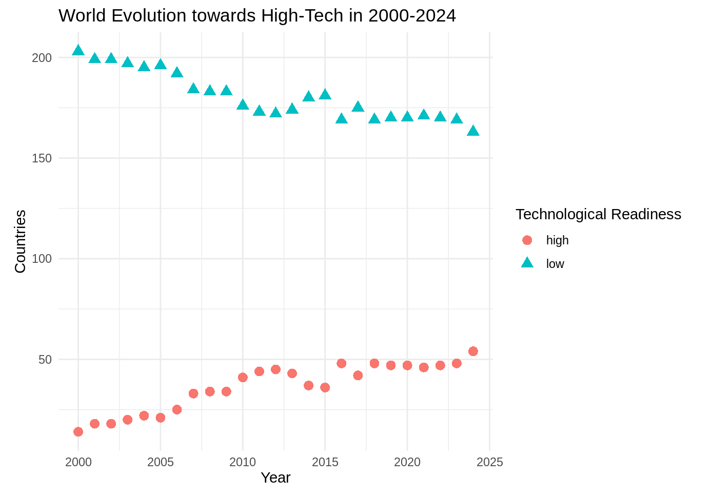
Evolution over time

Slide 10
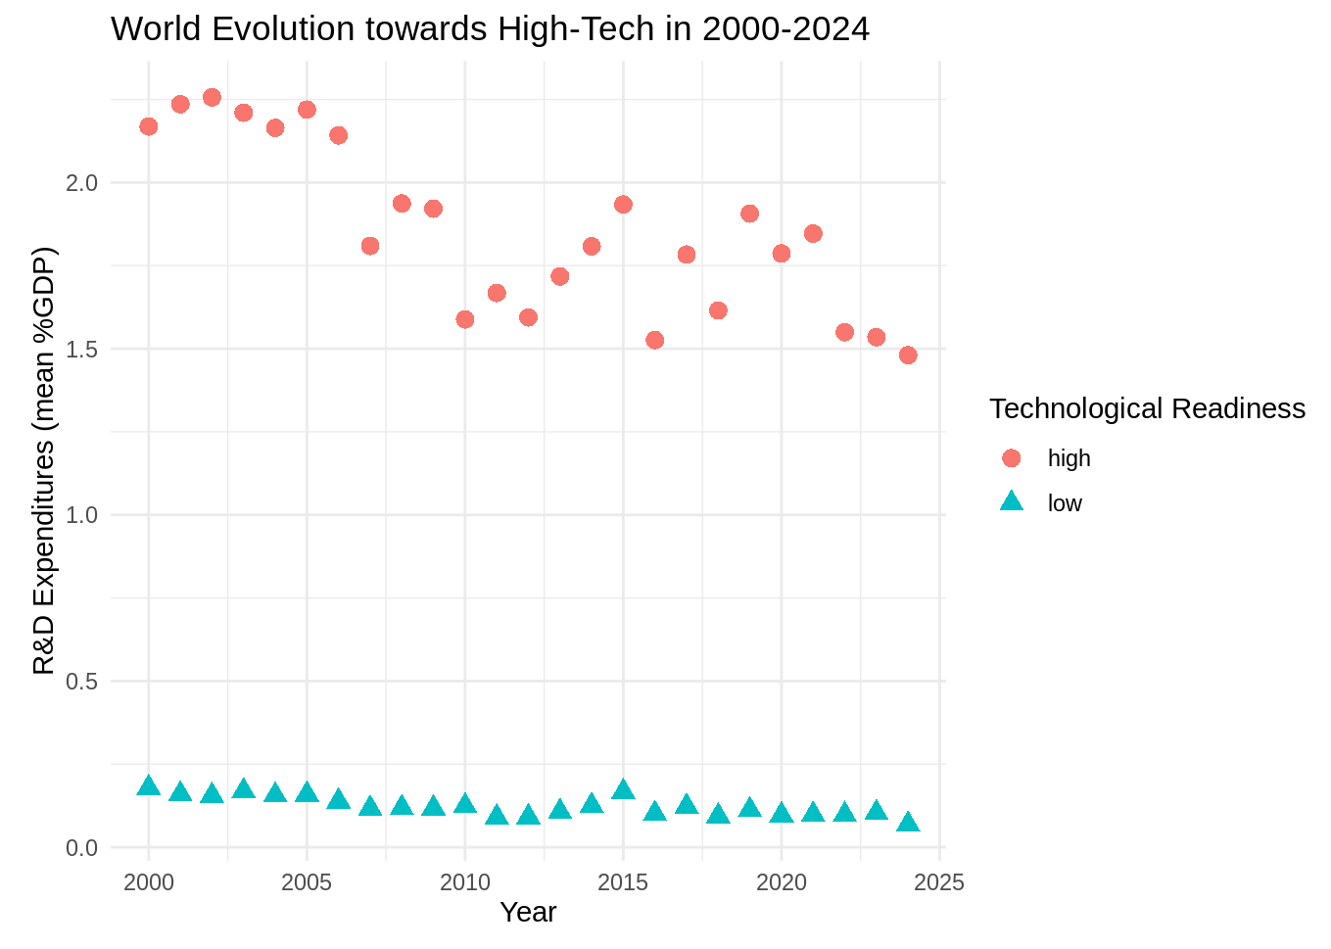
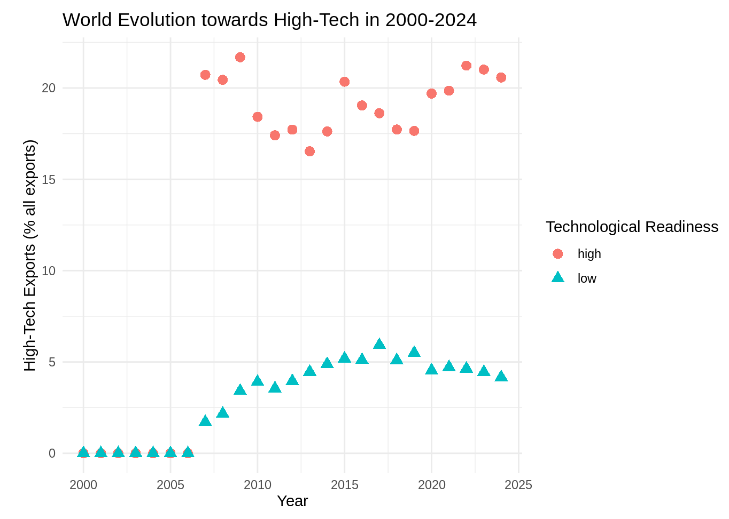

Slide 11
Conclusions
The logistic regression model (model_train) is statistically significant, predicting tech_readiness with high accuracy, precision, specificity and recall.
Initial analysis of how the indicators affect the predictions indicate that R&D expenditures and High-technology exports are among the most influential. But other indicators were important: access to electricity, researchers, scientific articles and internet users.
The time evolution of the differences between low and high countries shows that the gap in R&D expenditures (1.5% GDP) is slowly decreasing and the gap in High-tech exports (15% of all exports) is widening.

